Slide 1
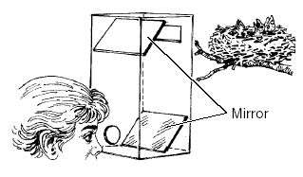
How a periscope works

Slide 2
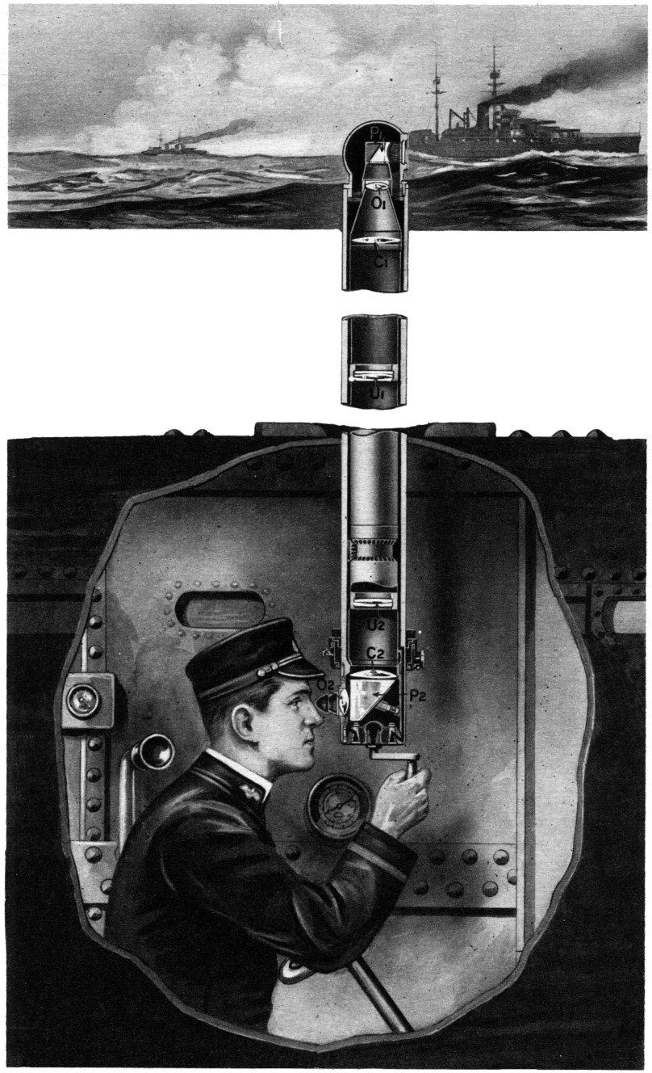
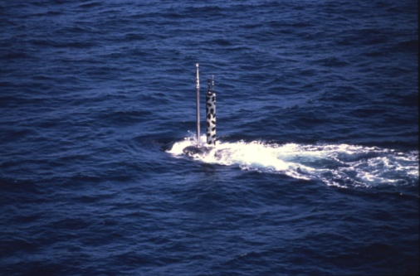
What is a periscope?
A periscope lets you see over the top of things, such as fences or walls that you aren't tall enough to look over. You can also use it to see around corners.
People first started using periscopes in submarines around the 1860s, to allow the sailors to see above the water.
Later, soldiers in the First World War used them to look out of the trenches without having to put their heads out of the trench.
Periscopes are still used today in tanks and some submarines.

Slide 3
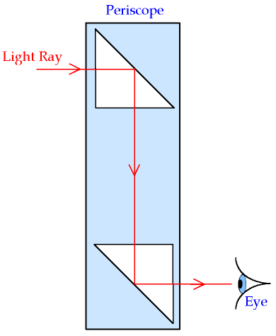
What is a periscope?
A simple periscope is just a long tube with a mirror at each end.
The mirrors are fitted into each end of the tube at an angle of exactly 45 degrees (45°) so that they face each other.
In the periscope, light hits the top mirror at 45° and reflects away at the same angle.
The light then bounces down to the bottom mirror. When that reflected light hits the second mirror it is reflected again at 45°, right into your eye. You can see this in the picture on the left.
Watch this video ‘How a periscope works’
http://www.youtube.com/watch?v=6MXbTXYIgqw

Slide 4
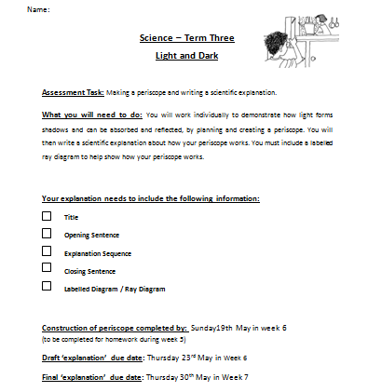
SCIENCE ASSESMENT TASK (TERM 3)
*Making a periscope and writing an explanation how a periscope works
(You will not get marks for your periscope but you will be marked on your EXPLANATION of how it works)

Slide 5
How to make a periscope
http://www.webinnate.co.uk/science/week8.htm
http://m.wikihow.com/Make-a-Periscope
Research what materials will you need to make your periscope?
Your periscope will be made at home and brought to class on Sunday of week 6.

Slide 6
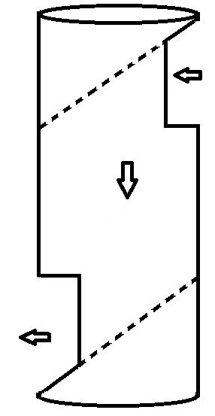
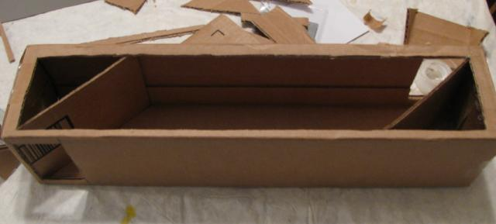
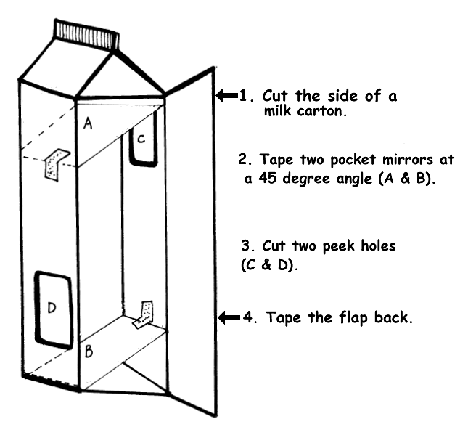
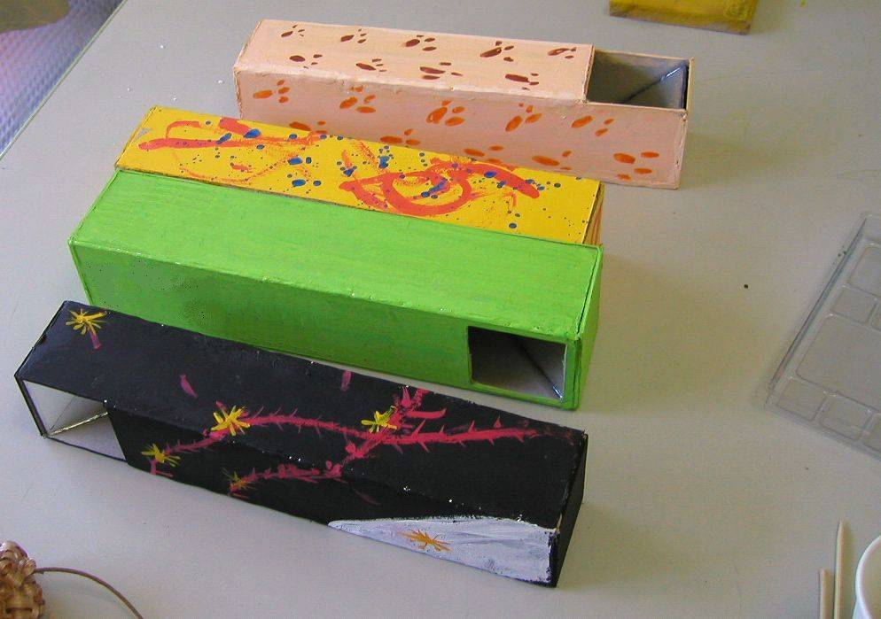
Periscope examples

Slide 7
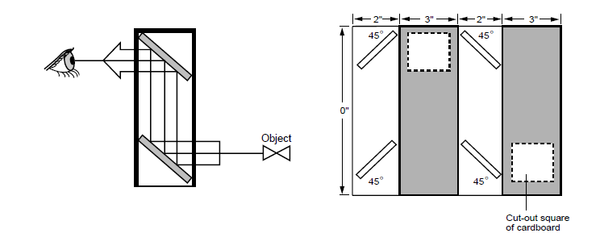
Periscope template

Slide 8
Scientific explanation
You will now write an explanation about how a periscope works and include a labelled ray diagram.
Do you remember the key parts of an explanation text?
→ Introduction (general statement about periscopes)
→Explanation sequence (how it works, set by step)
→Closing statement (a sentence to finish your explanation)
→Include a labelled ray diagram of your periscope
Your science draft is due Wednesday 11th in week 5 and the good copy for marking is due in week 6, Wednesday 18th May.

Slide 9
Title- How a periscope works
Opening sentence (introduce topic)-
A periscope is…. A periscope is made from….
We use a periscope to….
Explanation sequence
First the light travels…..
Next it reflects…..
TRY USING THESE SCIENCE WORDS:
Light eyes
Travels Reflect
Mirror straight line
Light source
angle
Closing sentence (to finish your explanation)-
Now you know how….. In conclusion…

Slide 10
Game- periscopes
http://www.bbc.co.uk/bitesize/ks2/science/physical_processes/how_we_see_things/play/

